Slide 1
Small-Scale Soil Health Group Activity
This exercise is designed to summarize your learning to use for future reference.
Please imagine that next year, a colleague who couldn’t attend the course is going to visit a small 2 acre farm. They ask you for help.
What are your takeaways from this course?
What information would you want to share with them?
Notes:
Refer to class Instructor Guide for additional instructions on the goals and use of these projects.

Slide 2
Please feel free to insert photos, change colors, layout, and font.
There are two slide layouts per group. You don’t have to use both slides. You are not obligated to use these slides at all if you prefer a different layout.
These resources are for your reference or to share with NRCS colleagues.

Slide 3
Group 1 Know Before You Go | Group 2 Beyond High Tunnels | Group 3 Differences Between Small and Large Scale | Group 4 Conversations with Small Scale Farmers | Group 5 Course Summary Presentation | Group 6 Other Needs for the Portfolio
Notes:
Use this table to keep track of who is in which group. Edit header row according to the projects that participants choose to work on .

Slide 4
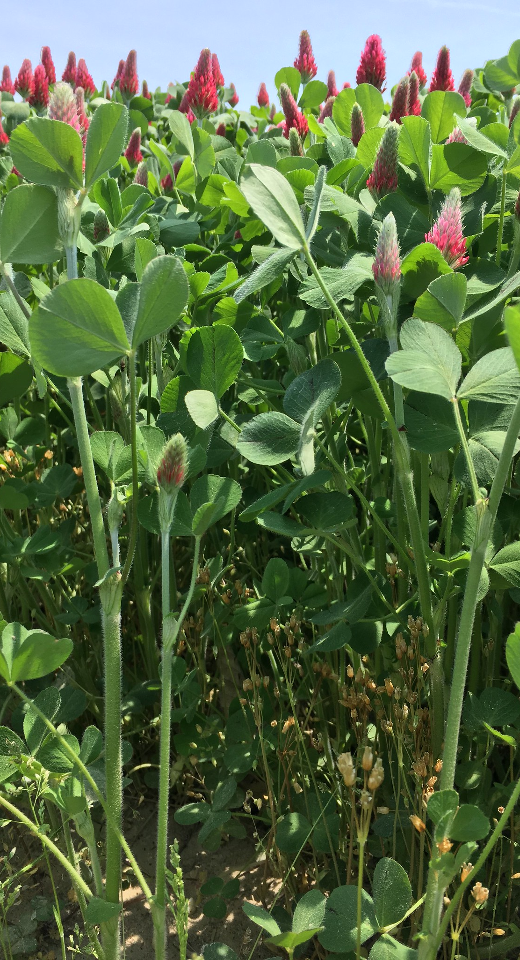
1
Item 1
01
Need Information
2
Item 2
02
Need Information
AGENDA SLIDE
3
Item 3
03
Need Information
Know Before You Go
Information needed before you conduct an small scale farm site visit
4
Item 4
04
Need Information
5
Item 5
05
Need Information
Group 1

Slide 5
Know Before You Go
Information needed before you conduct an small scale farm site visit
Add a photo/fig/map
Needed Information
Needed Information
Needed Information
Needed Information
Needed Information
Add a photo/fig/map
photo/fig/map
Group 1

Slide 6
Beyond High Tunnels
A cheat sheet of common suites of practices used in urban /small scale
Suite 1
Suite 2
Practices
Practices
Practices
Practices
Practices
Practices
Suite 3
Suite 4
Suite 5 or Insert Photo
Practices
Practices
Practices
Practices
Practices
Practices
Practices
Practices
Practices
Group 2

Slide 7
Beyond High Tunnels
A cheat sheet of common suites of practices used in urban /small scale
Suite 1
Suite 2
Suite 3
Suite 4
Suite 5
Practice
Practice
Practice
Practice
Practice
Practice
Practice
Practice
Practice
Practice
Practice
Practice
Practice
Practice
Practice
Group 2

Slide 8
Urban/Small- and Large-Scale Agriculture Comparison
SUBTITLE if needed
Feature
Urban/Small Scale
Large Scale
Feature 1
Feature 2
Explanation if needed
Explanation if needed
Feature 3
Explanation
Explanation
Feature 4
Feature 5
Feature 6
Group 3

Slide 9
Urban/Small- and Large-Scale Agriculture Comparison
SUBTITLE if needed
Small Scale
Large Scale
Difference
Difference
Difference
Difference
Difference
Difference
Similarity
Similarity
Similarity
Similarity
Group 3

Slide 10
Have a conversation:
Questions to ask a small scale/urban farmer
Group 4

Slide 11
Have a conversation:
Questions to ask a small-scale/urban farmer
Group 4

Slide 12
Ideas for other portfolio products
Group 6

